Slide 1







Employee Data Management Systems
Bootcamp Capstone Project
Presented by: Kanishka Sharma, Himanshu Kumar
Proudly recognized by

Slide 2
Table of Contents:
Introduction
Objectives and Key Outcomes
System Architecture & Data Flow
Data Processing Implementation
Reporting, Monitoring, and Alerts
Conclusion
Notes:
Agenda for next 2 days is:
WHAT IS ETL?
GLUE COMPONENTS
DATA CATALOG
CRAWLERS
JOB AUTHORING
HANDSON DEMO
we will cover some of the topics today and remaining tomorrow

Slide 3
Introduction
In today’s fast-paced organizations, efficiently managing employee data is key to operational excellence. This project introduces a robust data management platform built on AWS that handles real-time employee data using Kafka and PySpark.
The system brings together diverse datasets—like employee records, leave history, and communication logs—and transforms them into structured, enriched outputs using AWS Glue. It enables daily and monthly analytics to detect unusual leave patterns, communication misuse, and even automates HR insights like strike tracking and salary adjustments.

Slide 4

Objectives and Key Outcomes
Objectives:
Ingest and analyze employee data (leave, communication, records) in real time and batch modes.
Automate HR insights like leave abuse detection and strike tracking.
Ensure data reliability using scalable ETL pipelines and warehousing.
Key Outcomes:
Built real-time data pipelines using Kafka, PySpark, and AWS Glue.
Detected leave misuse and flagged inappropriate communication.
Flexible: Supports batch and realtime data processing.
Generated automated HR reports with salary and strike enforcement logic.

Slide 5
System Architecture:
Designed a scalable system to process employee data in real-time and batch modes.
Ingested leave records, communication logs, and employee details via AWS and Kafka.
Built automated ETL pipelines using PySpark and AWS Glue for reliable data transformation.
Detected excessive leave usage through daily (8%) and monthly (80%) thresholds.
Flagged inappropriate communication using keyword monitoring and Kafka streams.
Implemented strike tracking, salary deductions, and manager-specific HR reports.

Slide 6
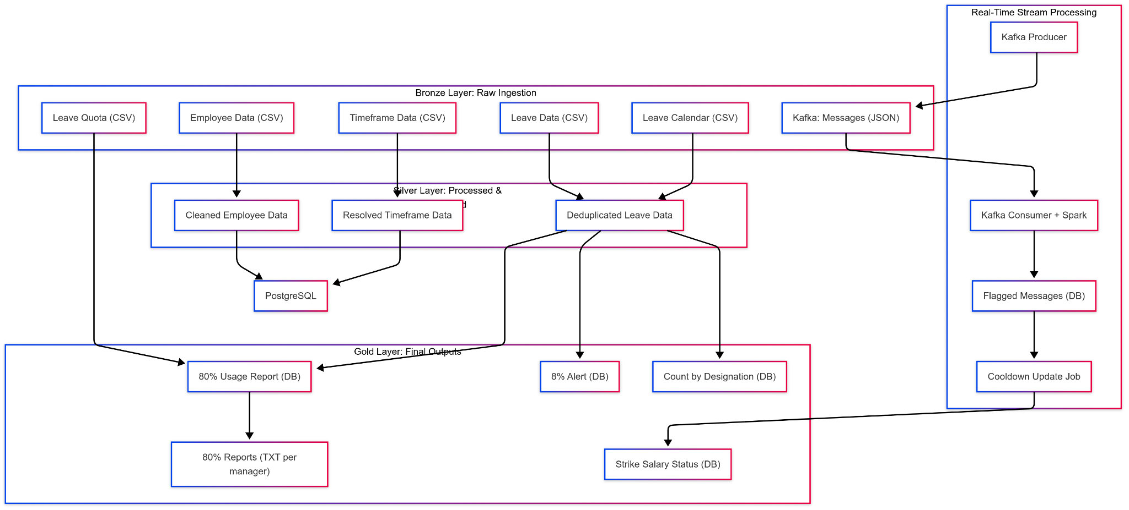
System Architecture:

Slide 7
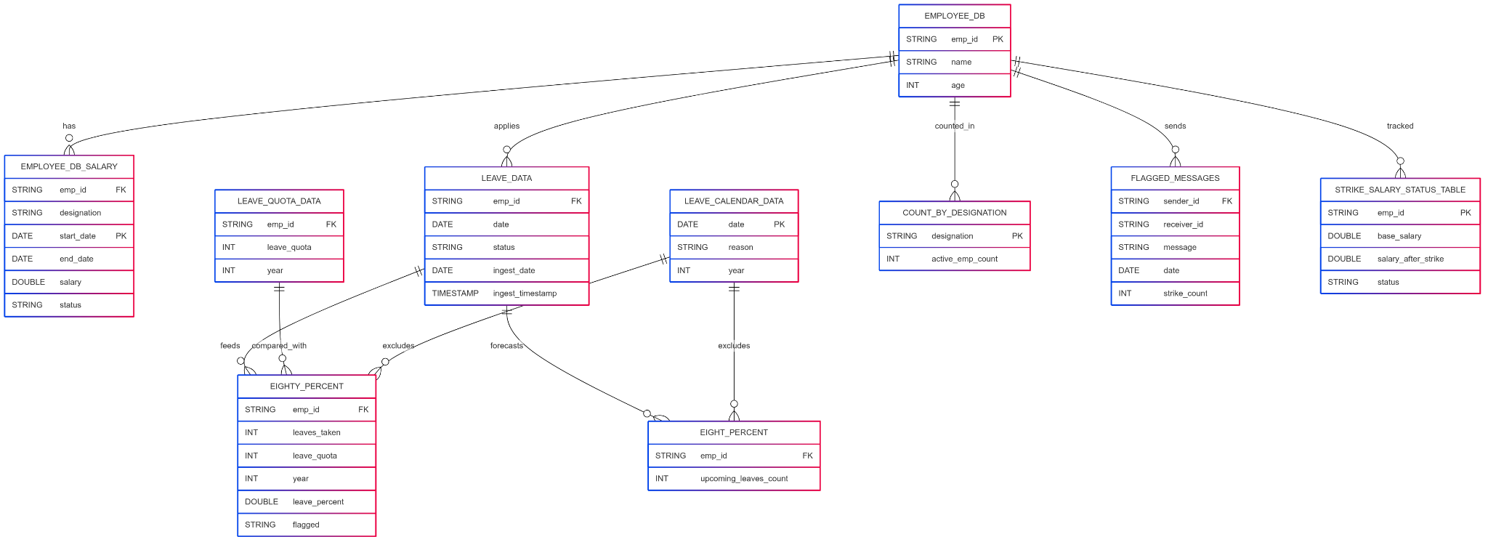
ER Diagram:
Notes:
AWS Glue Architecture Components:
Data Stores: Source & target storage (databases, S3, etc.).
Glue Crawler: Extracts metadata from data sources.
Data-Catalog: Centralized repository for metadata and schema information.
AWS Management Console: UI for managing Glue jobs, crawlers, and metadata.
ETL Job Execution: Transforms and loads data using scripts.
Scheduling & Events: Jobs can be triggered by schedules, AWS Lambda, or other event-driven mechanisms.

Slide 8
Data Flow:
Bronze Layer (Raw Ingestion): Ingests CSVs from S3 (employee, leave, quota) and real-time Kafka messages; stores raw data in S3 for lineage.
Silver Layer (Processed Data): Cleansed and enriched via AWS Glue & Spark; stored in PostgreSQL (e.g., leave data, flagged messages).
Gold Layer (Business Outputs): Generates reports (e.g., leave thresholds, strike salary summaries); outputs stored in S3 & PostgreSQL.
Streaming + Batch Support: Kafka for real-time messages, S3 for scheduled batch data ingestion.
Orchestration with Airflow: Schedules daily/monthly Glue jobs with retry logic and checkpointing.

Slide 9
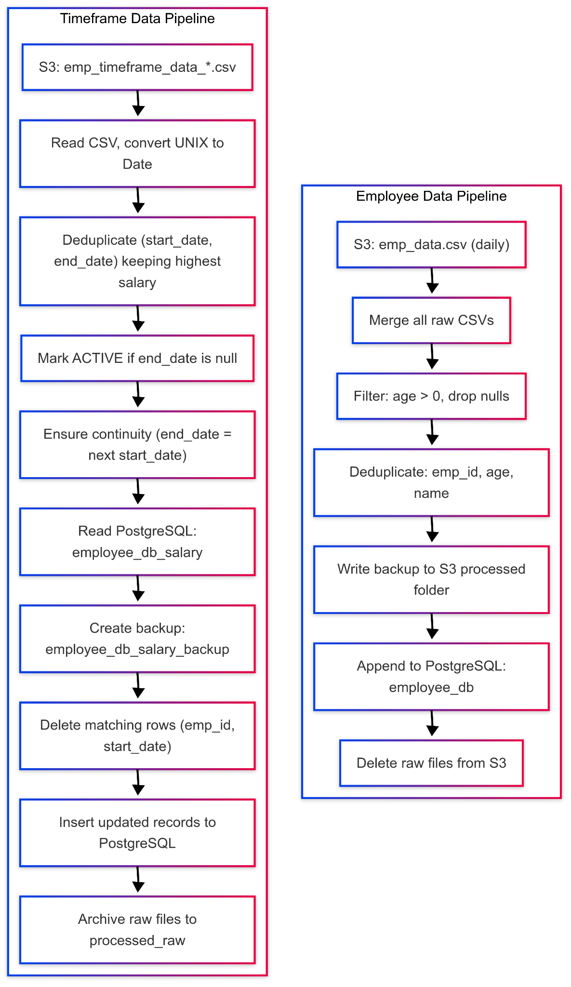
Employee Data and Timeframe Processing
Ingests and cleans employee master and designation data daily.
Maintains append-only tables with continuity logic and ACTIVE/INACTIVE status.
Deduplicates based on timestamps and updates PostgreSQL incrementally.

Slide 10
Employee Leave Data, Leave Quota & Calendar
Processes leave quotas, public holidays, and daily leave applications.
Stores cleaned data in PostgreSQL for dashboards and scheduled reports.
Excludes holidays, weekends, and cancelled leaves from final tables, Deduplicated yearly quotas per employee.
Cleaned public holidays for filtering leaves.
Validated daily leave entries excluding weekends, holidays, and cancellations.

Slide 11
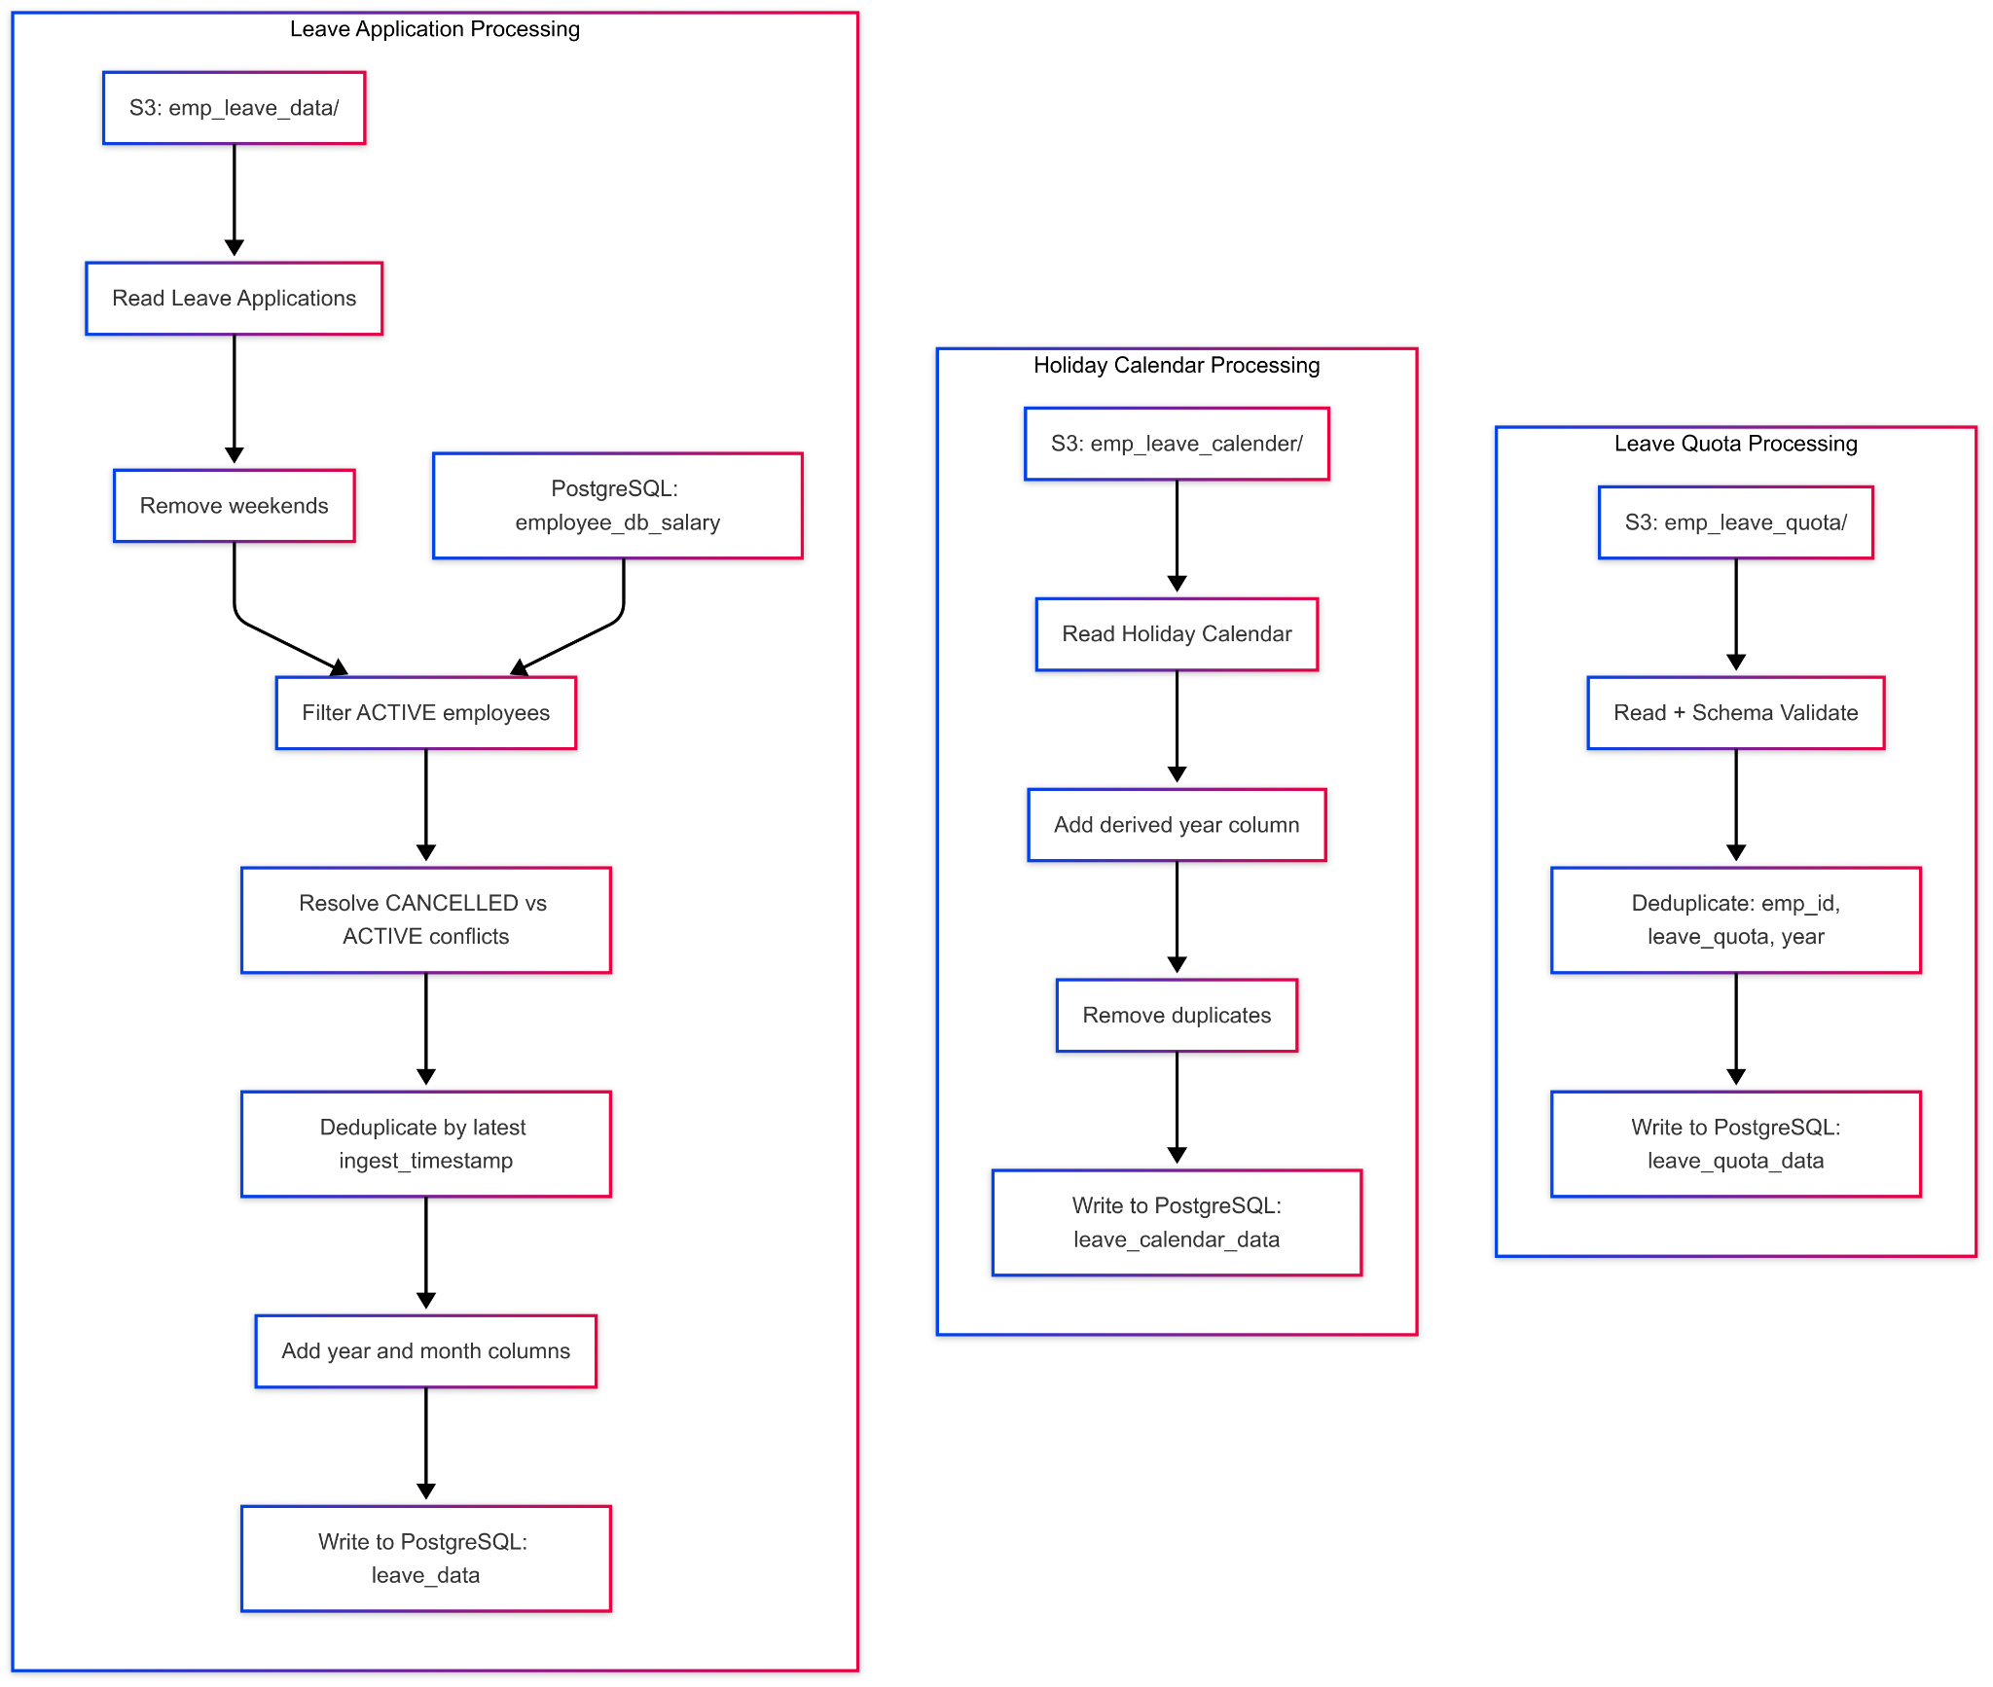
Employee Leave Data Processing

Slide 12
Employee Reporting and Alerting
Daily Report: Tracks active employees by designation.
8% Alert: Flags employees exceeding 8% of upcoming leave days.
80% Alert: Flags those using over 80% of their annual leave quota; generates manager reports.

Slide 13
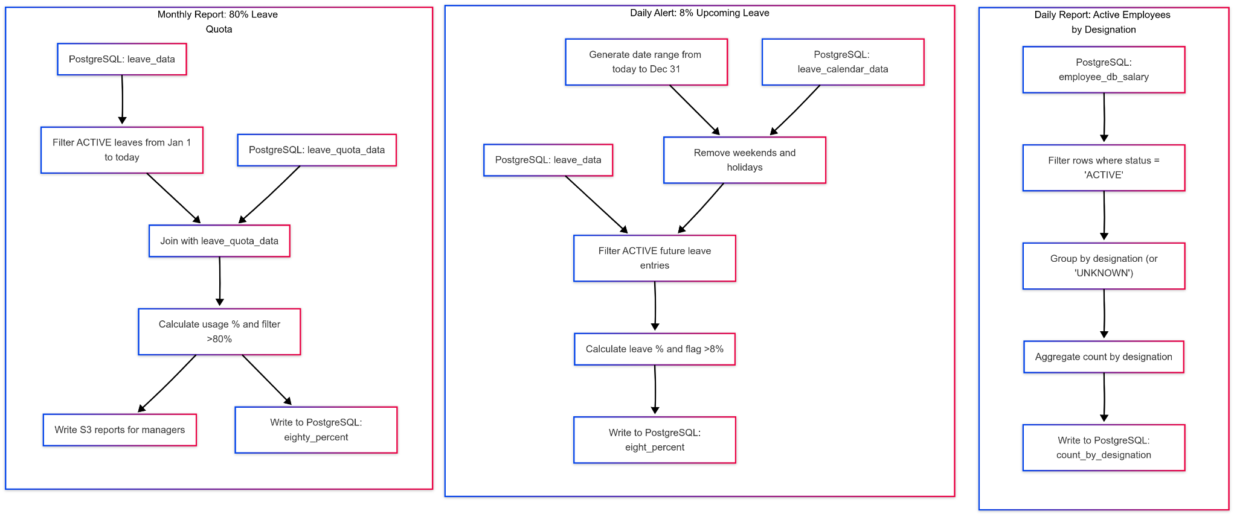
Employee Reporting and Alerting

Slide 14
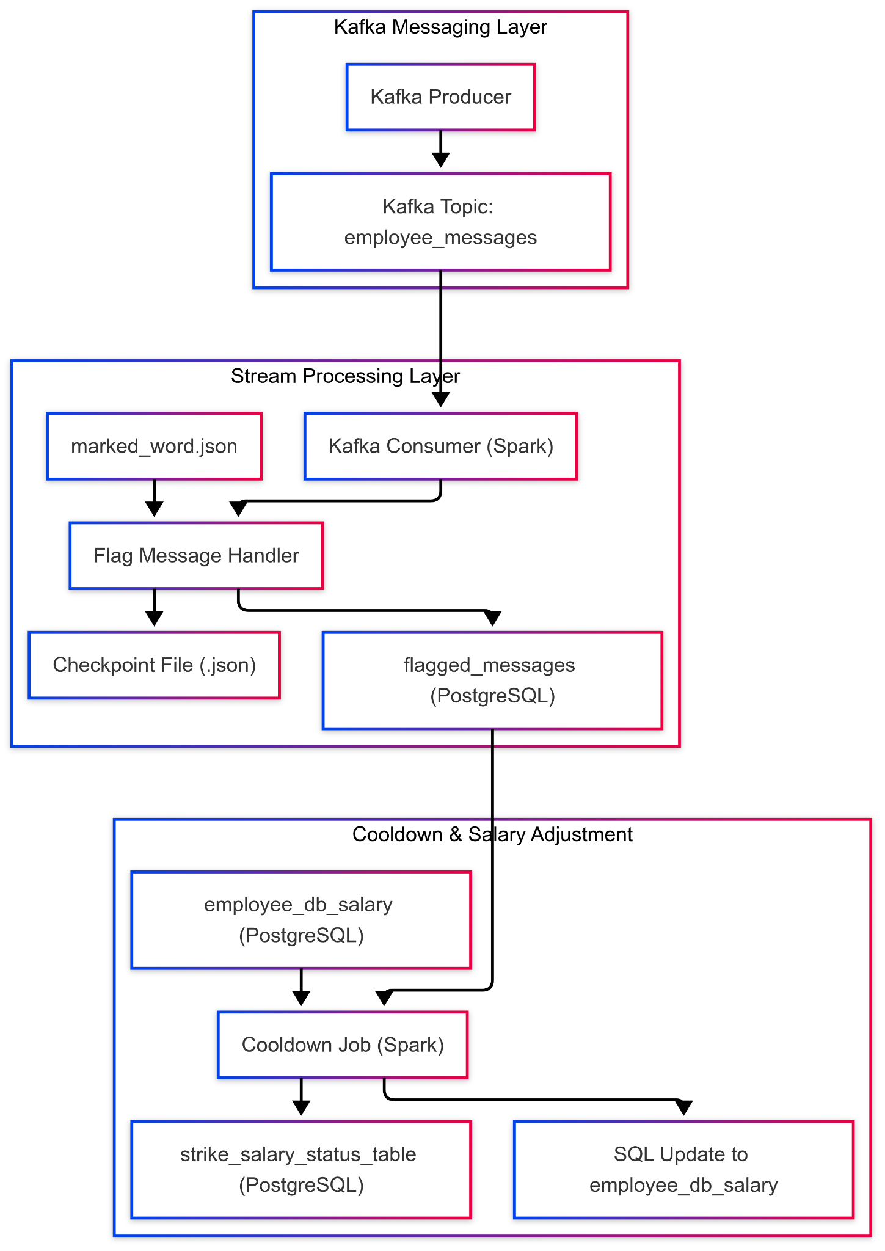
Real-Time Communication Monitoring
Kafka-based pipeline processes real-time employee messages.
Flags messages with reserved words and writes alerts to PostgreSQL.
Maintains checkpoints for fault tolerance.
Applies 10% salary deductions per strike with decay logic.
Employees with ≥10 strikes marked INACTIVE and salary frozen.
Updates PostgreSQL tables for strike status and employee state.

Slide 15
Airflow Orchestration:
Start: DAG begins with start, triggering employee_data_job and employee_timeframe_job.
Parallel Branching: These feed three paths — monthly check, designation report, and leave data processing.
Monthly Logic: check_monthly_flag runs monthly_80_percent_leave_checker only on the 1st of each month.
Daily Leave Checks: leave_data_job processes leave entries and passes to eight_percent_leave_checker.
Yearly Data Load: check_yearly_flag ensures leave_calendar_loader and leave_quota_loader run only once a year.
End: All paths merge at end, ensuring clean and complete execution flow.

Slide 16
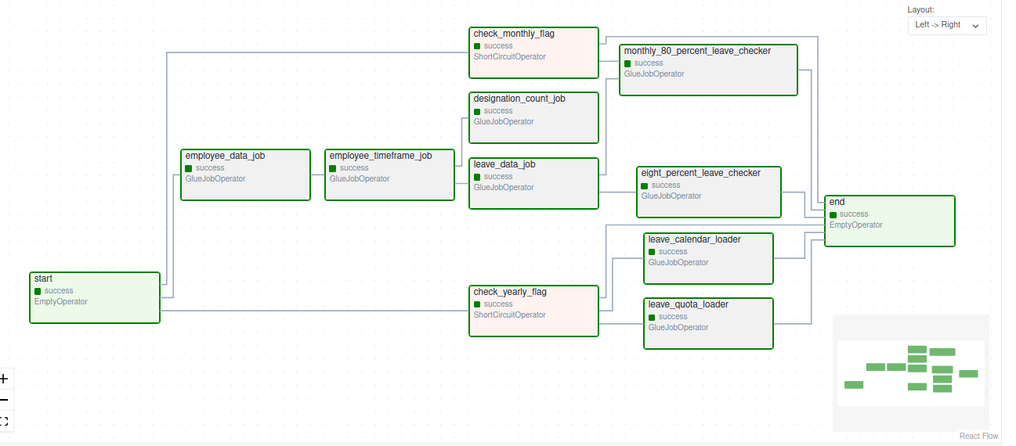
Airflow:
Notes:
AWS Glue provides multiple ways to create and manage data transformation jobs. Whether you're a beginner or an advanced user, AWS Glue offers tools suited for different skill levels.
Glue Studio simplifies ETL job creation for non-coders.
Developers use script editors for complex transformations.

Slide 17
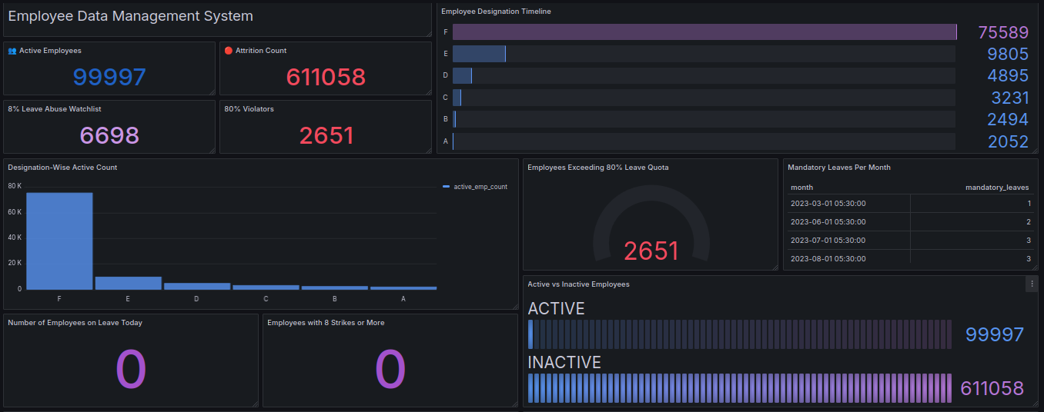
Dashboard:
Notes:
AWS Glue provides multiple ways to create and manage data transformation jobs. Whether you're a beginner or an advanced user, AWS Glue offers tools suited for different skill levels.
Glue Studio simplifies ETL job creation for non-coders.
Developers use script editors for complex transformations.

Slide 18
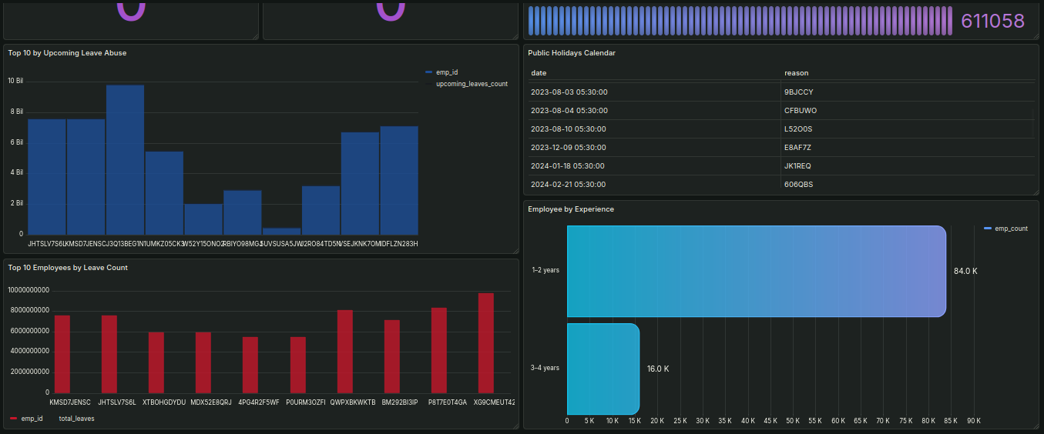
Dashboard:

Slide 19
Conclusion:
The Employee Data Management System successfully demonstrates the integration of batch and streaming data pipelines to manage critical employee information at scale. By leveraging AWS services such as S3, Glue, and EC2-hosted PostgreSQL, along with Apache Kafka for real-time communication monitoring, the system ensures timely ingestion, accurate processing, and reliable reporting.
This project showcases a scalable and fault-tolerant design aligned with modern data warehouse principles and lays the foundation for future enhancements such as alert automation, employee self-service dashboards, and advanced behavioral analytics.

Slide 20





